Slide 1
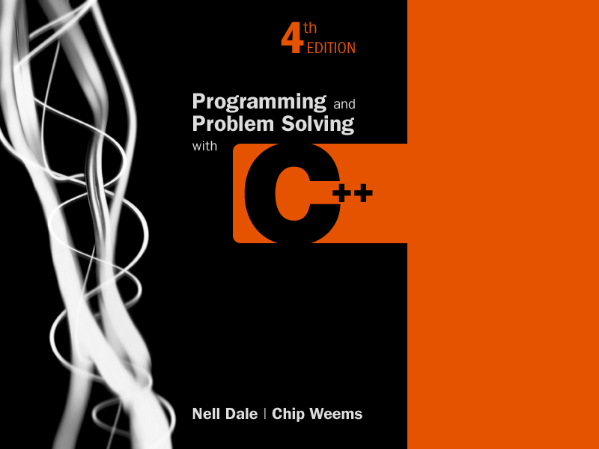
Chapter 15-2
Pointers, Dynamic Data, and Reference Types
Dale/Weems

Slide 2
What happens here?
int* ptr = new int;
*ptr = 3;
ptr = new int; // Changes value of ptr
*ptr = 4;
3
ptr
3
ptr
4

Slide 3
Inaccessible Object
An inaccessible object is an unnamed object created by operator new that a programmer has left without a pointer to it.
int* ptr = new int;
*ptr = 8;
int* ptr2 = new int;
*ptr2 = -5;
How else can an object become inaccessible?
8
ptr
-5
ptr2

Slide 4
Making an Object Inaccessible
8
ptr
-5
ptr2
int* ptr = new int;
*ptr = 8;
int* ptr2 = new int;
*ptr2 = -5;
ptr = ptr2;
//Here the 8 becomes
// inaccessible
8
ptr
-5
ptr2

Slide 5
Memory Leak
A memory leak is the loss of available memory space that occurs when dynamic data is allocated but never deallocated

Slide 6
A Dangling Pointer
A dangling pointer is a pointer that points to dynamic memory that has been deallocated
int* ptr = new int;
*ptr = 8;
int* ptr2 = new int;
*ptr2 = -5;
ptr = ptr2;
8
ptr
-5
ptr2
For example,

Slide 7
Leaving a Dangling Pointer
8
ptr
-5
ptr2
int* ptr = new int;
*ptr = 8;
int* ptr2 = new int;
*ptr2 = -5;
ptr = ptr2;
delete ptr2;
// ptr is left dangling
ptr2 = NULL;
8
ptr
NULL
ptr2

Slide 8
Reference Types
int& intRef;
Reference Type Declaration
DataType& Vaiable;
DataType &Variable, &Variable, …;

Slide 9
Use reference variable
Use reference variable as alias
int someInt;
int& intRef = someInt;
intRef = 1;
void DatePrint(Date& someDate) {
someDate.Print();
}

Slide 10
The difference of using a reference variable and using a pointer variable
Using a Reference Variable
int gamma = 26;
int& intRef = gamma;
// Assert: intRef points to gamma
intRef = 35;
// Assert: gamma == 35
intRef = intRef + 3;
// Assert: gamma == 38
Using a Pointer Variable
int gamma = 26;
int* intPtr = &gamma;
// Assert: intPtr points to gamma
*intPtr = 35;
// Assert: gamma == 35
*intPtr = *intPtr + 3;
// Assert: gamma == 38

Slide 11
Reference Variables are Constant Pointers
Reference variables cannot be reassigned after initialization
Initialization means:
Explicit initialization in a declaration
Implicit initialization by passing an argument to a parameter
Implicit initialization by returning a function value

Slide 12
The use of reference variables
The following code fails:
void Swap(float x, float y) {
float temp = x;
x = y;
y = temp;
}
Swap(alpha, beta);

Slide 13
The use of reference variables
The following code uses pointer variables:
void Swap(float* x, float* y) {
float temp = *x;
*x = *y;
*y = temp;
}
Swap(&alpha, &beta);

Slide 14
The use of reference variables
The following code uses reference variables:
void Swap(float& x, float& y) {
float temp = x;
x = y;
y = temp;
}
Swap(alpha, beta);

Slide 15
The usage of Ampersand (&)
Position | Usage | Meaning
Prefix | &Variable | Address of operation
Infix | Expression & Expression | Bitwise AND operation
Infix | Expression && Expression | Logical AND operation
Postfix | DataType& | DataType (specifically, a reference type) Exception: To declare two variables of reference types, the & must be attached to each variable name: Int &var1, &var2;

Slide 16
// Specification file (“dynarray.h”)
// Safe integer array class allows run-time specification
// of size, prevents indexes from going out of bounds,
// allows aggregate array copying and initialization
class DynArray
{
public:
DynArray(/* in */ int arrSize);
// Constructor
// PRE: arrSize is assigned
// POST: IF arrSize >= 1 && enough memory THEN
// Array of size arrSize is created with // all elements == 0 ELSE error message
DynArray(const DynArray& otherArr);
// Copy constructor
// POST: this DynArray is a deep copy of otherArr
// Is implicitly called for initialization

Slide 17
// Specification file continued
~DynArray();
// Destructor
// POST: Memory for dynamic array deallocated
int ValueAt (/* in */ int i) const;
// PRE: i is assigned
// POST: IF 0 <= i < size of this array THEN
// FCTVAL == value of array element at index i
// ELSE error message
void Store (/* in */ int val, /* in */ int i)
// PRE: val and i are assigned
// POST: IF 0 <= i < size of this array THEN
// val is stored in array element i
// ELSE error message

Slide 18
// Specification file continued
void CopyFrom (/* in */ DynArray otherArr);
// POST: IF enough memory THEN
// new array created (as deep copy)
// with size and contents
// same as otherArr
// ELSE error message.
private:
int* arr;
int size;
};

Slide 19
class DynArray
Free store
6000
DynArray
80
40
90
?
?
Private data:
size 5
arr 6000
~DynArray
DynArray
ValueAt
Store
CopyFrom

Slide 20
DynArray beta(5); //constructor
beta
Free store
2000
DynArray
?
?
?
?
?
Private data:
size 5
arr 2000
~DynArray
DynArray
ValueAt
Store
CopyFrom

Slide 21
DynArray::DynArray(/* in */ int arrSize)
// Constructor
// PRE: arrSize is assigned
// POST: IF arrSize >= 1 && enough memory THEN
// Array of size arrSize is created with // all elements == 0 ELSE error message
{
int i;
if (arrSize < 1)
{
cerr << “DynArray constructor - invalid size: “
<< arrSize << endl;
exit(1);
}
arr = new int[arrSize]; // Allocate memory
size = arrSize;
for (i = 0; i < size; i++)
arr[i] = 0;
}

Slide 22
beta.Store(75, 2);
beta
Free store
2000
DynArray
?
?
75
?
?
Private data:
size 5
arr 2000
~DynArray
DynArray
ValueAt
Store
CopyFrom

Slide 23
void DynArray::Store (/* in */ int val, /* in */ int i)
// PRE: val and i are assigned
// POST: IF 0 <= i < size of this array THEN
// arr[i] == val
// ELSE error message
{
if (i < 0 || i >= size)
{
cerr << “Store - invalid index : “ << i << endl;
exit(1);
}
arr[i] = val;
}

Slide 24
DynArray gamma(4);//Constructor
gamma beta
3000
2000
DynArray
DynArray
?
?
?
?
?
?
75
?
?
Private:
size 4
arr 3000
Private:
size 5
arr 2000
~DynArray
~DynArray
DynArray
DynArray
ValueAt
ValueAt
Store
Store
CopyFrom
CopyFrom

Slide 25
gamma.Store(-8,2);
gamma beta
3000
2000
DynArray
DynArray
?
?
-8
?
?
?
75
?
?
Private:
size 4
arr 3000
Private:
size 5
arr 2000
~DynArray
~DynArray
DynArray
DynArray
ValueAt
ValueAt
Store
Store
CopyFrom
CopyFrom

Slide 26
int DynArray::ValueAt (/* in */ int i) const
// PRE: i is assigned
// POST: IF 0 <= i < size THEN
// Return value == arr[i]
// ELSE halt with error message
{
if (i < 0 || i >= size)
{
cerr << “ValueAt - invalid index : “ << i
<< endl;
exit(1);
}
return arr[i];
}

Slide 27
Why is a destructor needed?
When a DynArray class variable goes out of scope, the memory space for data members size and pointer arr is deallocated
But the dynamic array that arr points to is not automatically deallocated
A class destructor is used to deallocate the dynamic memory pointed to by the data member

Slide 28
class DynArray Destructor
DynArray::~DynArray()
// Destructor
// POST: Memory for dynamic array deallocated
{
delete [ ] arr;
}

Slide 29
The End of Chapter 15 Part 2

